Slide 1
Sensor Data

Slide 2
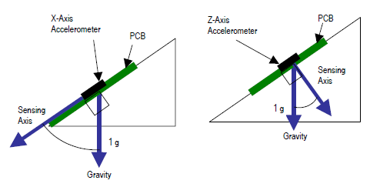
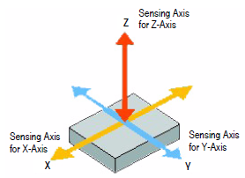
3-axis Accelerometer
an accelerometer at rest on the surface of the earth will measure an acceleration g= 9.81 m/s2 straight upwards, due to its weight

Slide 3
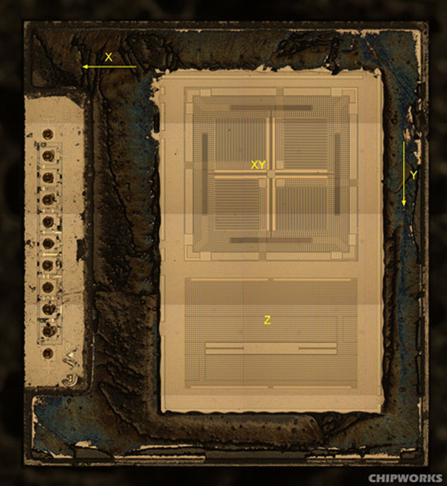
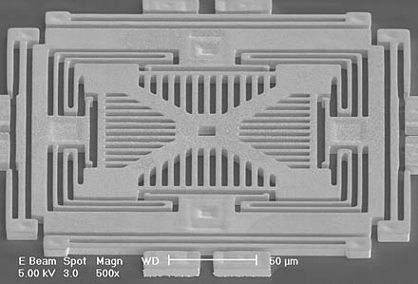
3-axis Accelerometer

Slide 4
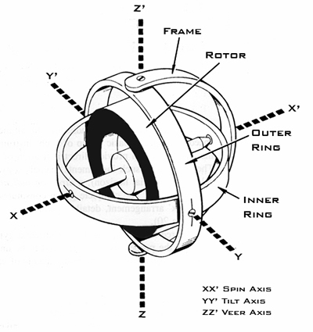
3-axis Gyroscope
A gyroscope is a device for measuring or maintaining orientation, based on the principles of angular momentum, it is to measure the rate of changes of the angles (deg/s)

Slide 5
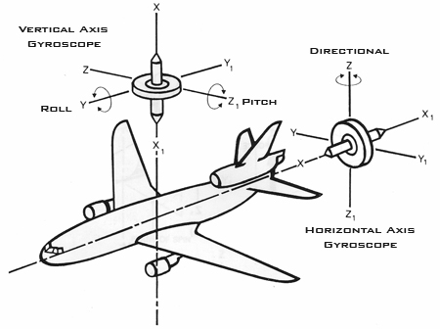
3-axis Gyroscope
Rigidity in space refers to the principle that a wheel with a heavily weighted rim spun rapidly will remain in a fixed position in the plane in which it is spinning.

Slide 6
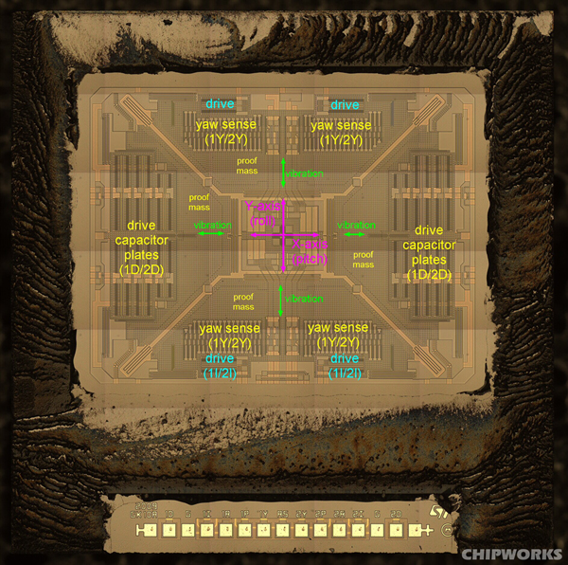
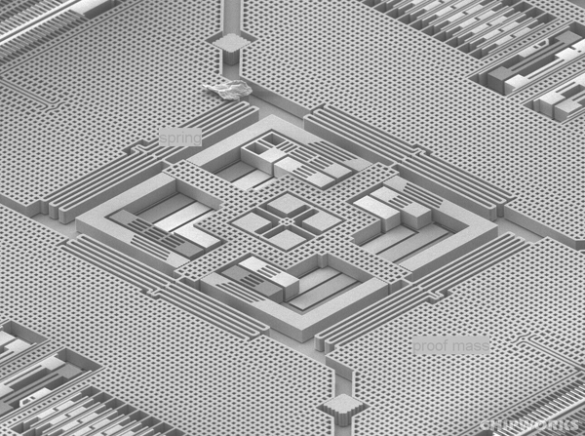
3-axis Gyroscope

Slide 7
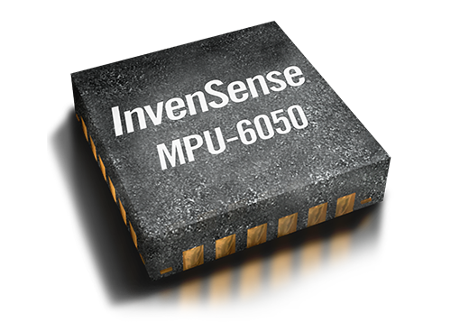
MPU6050
An inertial measurement unit (IMU) is used to measure 3-axis acceleration and 3-axis gyroscope in the unit g and deg/sec. MPU-6050 6-axis motion processor is used for this task. It has I2C bus connection allowing the device to gather data using only two wires, full scale range can be configured from ±2g to ±16g for the accelerometer and ±250°/s to 2000°/s for the gyroscope. The MPU-6050 also uses ADCs for digitizing the accelerometer outputs.

Slide 8
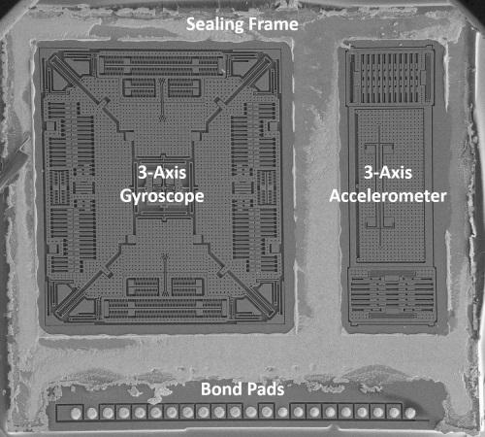
MPU6050

Slide 9
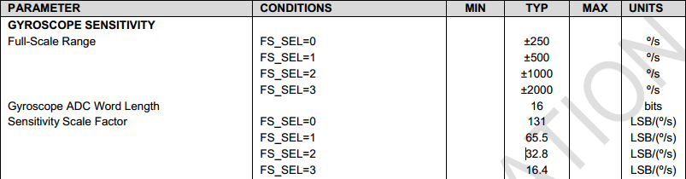
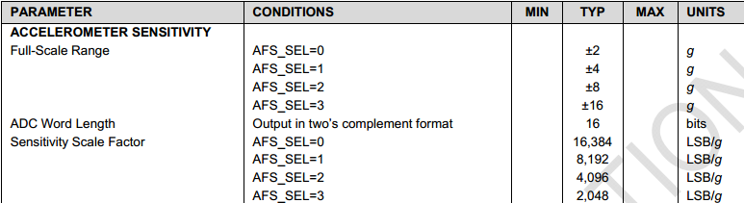
Full Scale Range of MPU6050

Slide 10
Raw Data Processing
The MPU-6050 features ADC that converts analog voltage to a binary number and then to a digital number in base 10 for reading, while analog accelerometers gives voltage level within a predefined range as output that since has to be converted to a digital value using ADC.
The MPU6050 gives 8-bit low and 8-bit high output, combined those bits give 16-bit as output for each of the 6 axis.
A mathematical relationship shows how the numbers of bits an ADC handles. For example, 16-bit output gives a value in the range of 2^16 = 65536 or numbers on the scale 0 to 65535.

Slide 11


Raw Data Processing
A 16-bit ADC resolution with maximum 3.3V input is:
By dividing the raw accelerometer data by a sensitivity scale factor of 16384 LSB/g for the setting ±2g the data can be converted into multiplies of g.
Dividing the raw gyro data by sensitivity scale factor of 131 LSB/°/s for the setting ± 250°/s gives angular velocity in °/s.

Slide 12
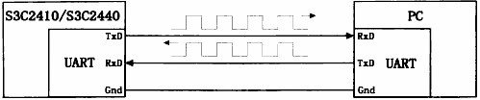

UART

Slide 13
UART
Baud：The speed of transmission, for example, 9600 baud = 9600 bits/s,
Which means can transmit 9600 bit per second

Slide 14
IIC Bus
I2C bus is a multi master bus able to transfer data between two equipment using only two lines, a serial data line and a serial clock line.
When I2C is used to carry information each device is recognized by a unique address.
Vdd
SDA (Serial Data Line)
SCL (Serial Clock Line)
SCLKN1 out
DATA1 out
SCLK in
DATA in
Device

Slide 15
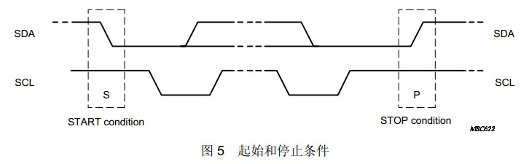
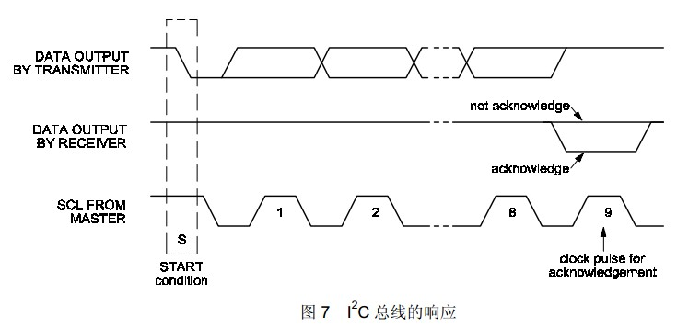
IIC Bus

Slide 16
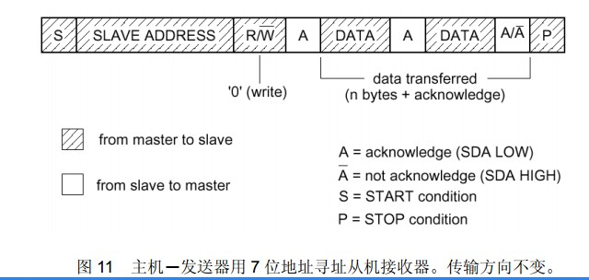
IIC Bus

Slide 17


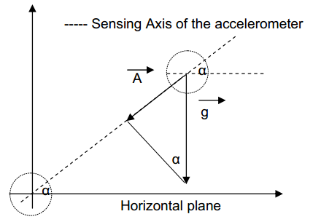
Single-axis tilt sensing
where: A = acceleration measured, g = Earth gravity vector

Slide 18
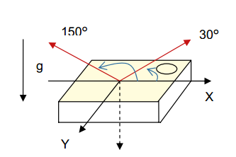
Dual-axis tilt sensing
Without the help of a third axis (for example the Z axis), it is impossible to distinguish a tilt angle of 30° from one of 150° because the X axis has the same outputs at these two tilt angles

Slide 19
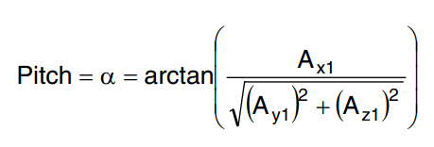
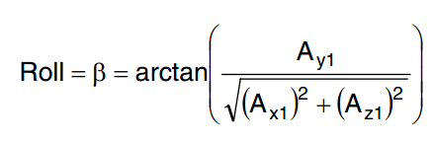
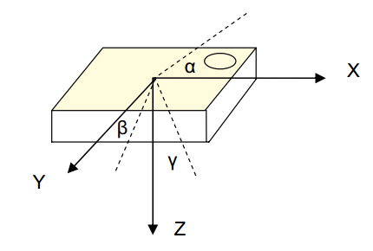
Tri-axis tilt sensing

Slide 20
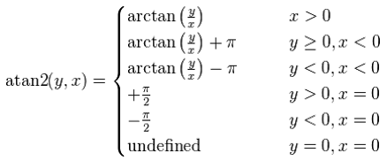
Function：atan2
We use atan2(y,x) instead of atan(y/x) in C programming.

Slide 21
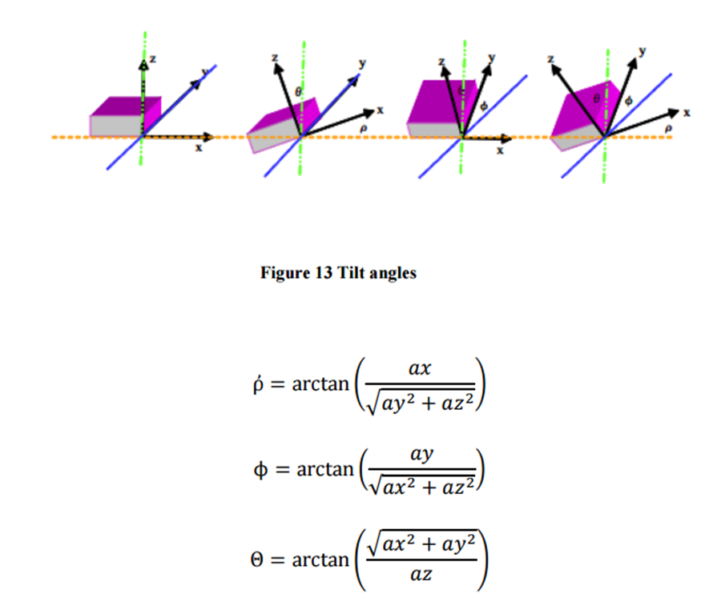
Using atan2

